Slide 1

Minesweeper
Algorithms &
Data Structure
Nguyễn Vĩnh Trí ITDSIU19021
Trương Công Trung ITITIU19059

Slide 2
I. GUI

Slide 3
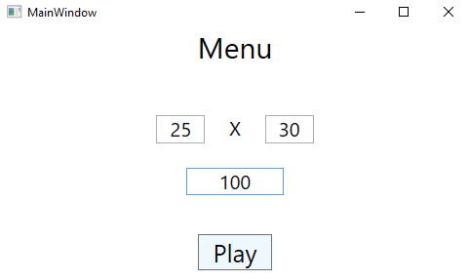
I. GUI

Slide 4
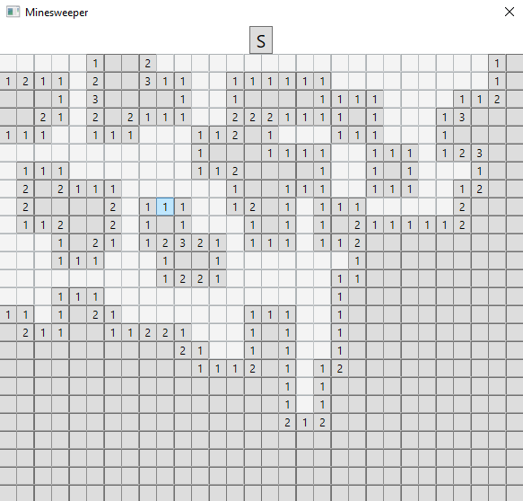
I. GUI

Slide 5
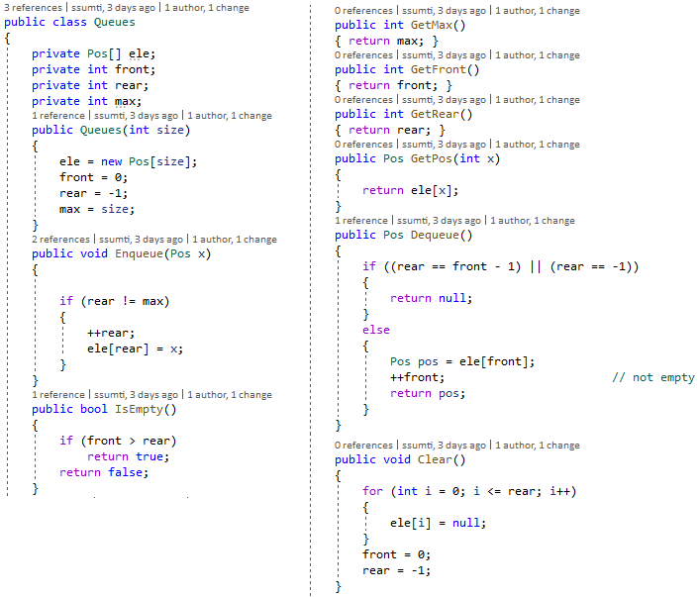
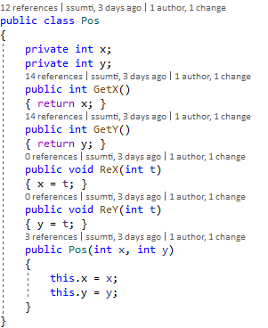
II. Data structures

Slide 6
III. Game processing

Slide 7
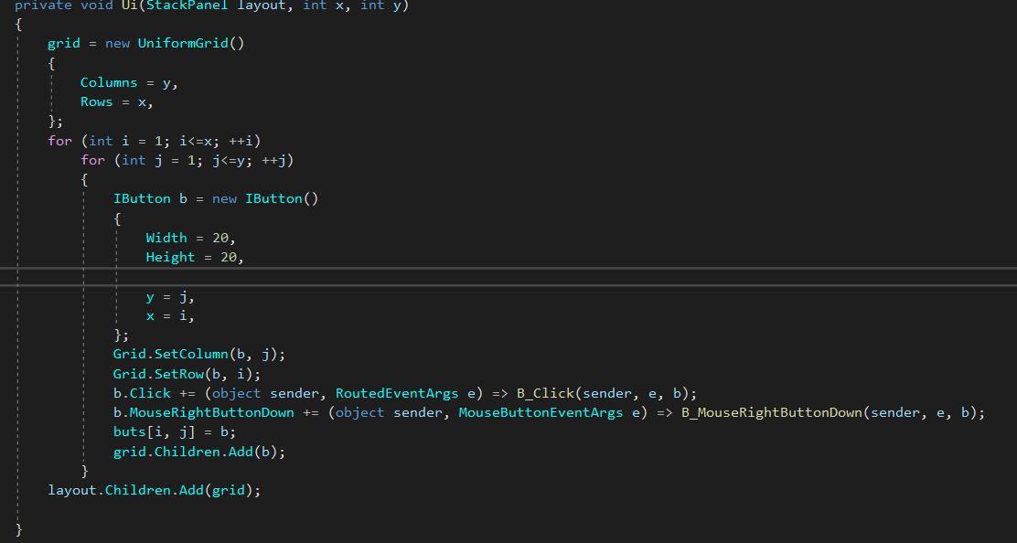
UI FORM

Slide 8
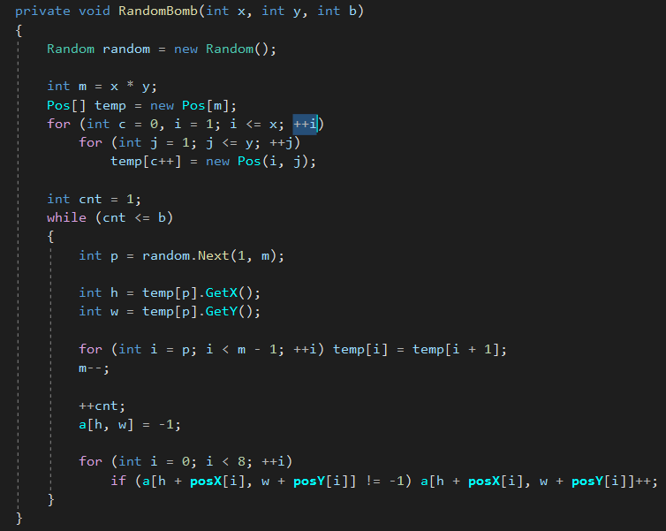
Initialize

Slide 9
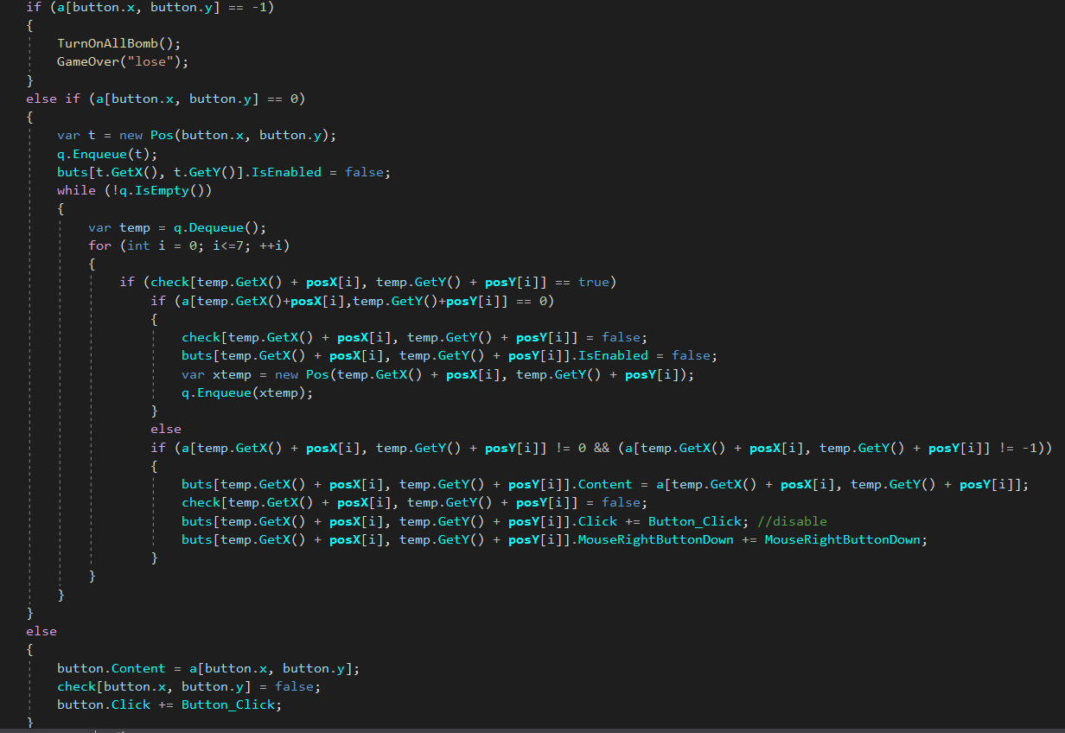
Processing

Slide 10
IV. DEMO

Slide 11
Thank you for listening!

